Slide 1
Why Environmental Justice Matters for us All
David N. Pellow
UC AMP
April 26, 2022
Notes:
40 minutes plus 10 of Q&A
Land acknowledgement

Slide 2
Key issues and questions
How are social inequality and environmental quality linked?
What roles do social movements play in shaping environmental policy?
How can we improve people’s quality of life and promote ecological sustainability?

Slide 3
Environmental Inequality/Injustice
Environmental inequality occurs when any marginal population suffers a disproportionately high burden of environmental harm and is excluded from environmental decisions affecting their communities.
Includes people of color, low wealth populations, Indigenous communities, immigrants, LGBTQ folk, women, people with disabilities and more

Slide 4
Environmental Racism
the unequal protection against toxic and hazardous waste exposure, climate impacts and the systematic exclusion of people of color from environmental decisions affecting their communities (including natural resource extractive activities)

Slide 5
Racism
Racism is not limited to the acts of individual bigots; it is a centuries-old practice perpetrated on a massive scale by institutions, corporations, and governments every day. It is also far more than merely prejudice and discrimination; ultimately racism is “group-differentiated vulnerability to premature death”
Source: Ruth Wilson Gilmore. 2007. Golden Gulag: Prisons, Surplus, Crisis, and Opposition in Globalizing California. University of California Press.

Slide 6
Environmental Justice
“The fair treatment and meaningful involvement of all people regardless of race, color, national origin, or income with respect to the development, implementation, and enforcement of environmental laws, regulations, and policies.” (USEPA)
EJ is a goal and a vision, in which no community is unfairly burdened with pollution or other environmental harms and when social justice and ecological sustainability prevail.

Slide 7
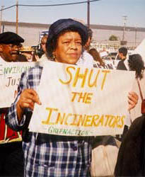
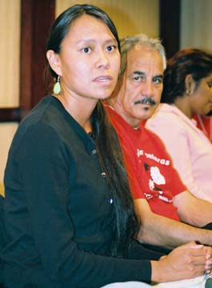
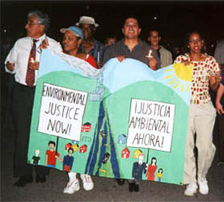
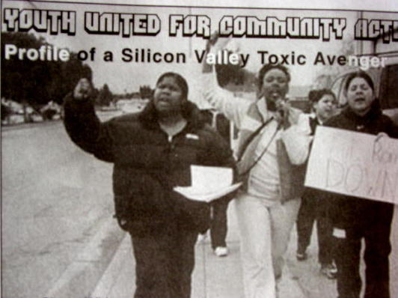
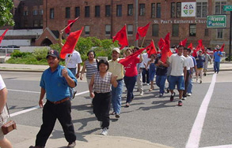
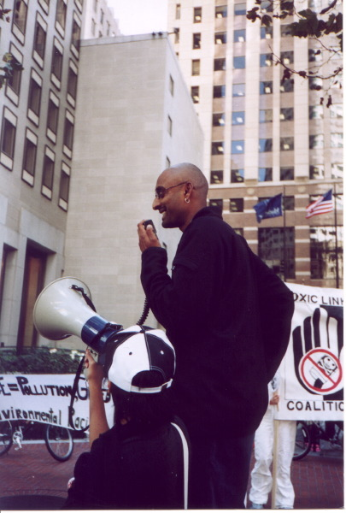
Notes:
Much of the EJ movement fights against locally unwanted land uses (LULUs)—incinerators, landfills, waste dumps, Superfund sites, coal fired power plants, etc, BUT it is also a movement that is fighting FOR clean air, land, water, and democracy.

Slide 8
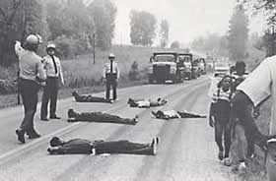
Fighting for Our Lives
Notes:
Historic protest against PCB landfill expansion, Warren County, NC, 1982

Slide 9
Indigenous sovereignty, climate and environmental justice in the Dakotas

Slide 10
ASIAN PACIFIC ENVIRONMENTAL NETWORK

Slide 11
Mauna Kea protest
Notes:
This UCSB Administration has yet to support the traditional custodians of these lands, Chumash people and Indigenous students, through their continued support of the Thirty Meter Telescope atop Mauna Kea. We also know that UCSB continues to hold human remains of Chumash ancestors with no clear plans of repatriation.

Slide 12
CAUSE—CENTRAL COAST ALLIANCE UNITED FOR A SUSTAINABLE ECONOMY

Slide 13
Will Allen, Growing Power, Milwaukee

Slide 14
Research on Environmental Inequalities
Empirical evidence of the correlation between race, class, immigration status and exposure or proximity to pollutants (since the early 1970s). This thesis is supported by hundreds of studies.
Communities of color and poor communities face disproportionate environmental risk and exposure
Analyzes political responses to environmental inequalities (e.g., environmental justice movement)

Slide 15
“Minority Move-in” Hypothesis
the idea that perhaps environmental racism is the result of people of color moving into areas where hazardous industries are located, rather than the other way around
.

Slide 16
“Minority Move-in” Hypothesis
the idea that perhaps environmental racism is the result of people of color moving into areas where hazardous industries are located, rather than the other way around
Actually: facilities tend to be located in communities that are already heavily nonwhite
Environmental/racial disparities increased after people of color move in. Discrimination and sociopolitical forces are most salient factors (translation: the hypothesis is wrong).
Source: Paul Mohai and Robin Saha. 2015. “Which came first, people or pollution? Assessing the disparate siting and post-siting demographic change hypotheses of environmental injustice.” Environmental Research Letters doi:10.1088/1748-9326/10/11/115008
.
Notes:
In a 2015 study, Paul Mohai and Robin Saha used a national database of commercial hazardous waste facilities sited from 1966 to 1995 and examined the demographic composition of host neighborhoods around the time of siting and demographic changes that occurred after siting. They found strong evidence of disparate siting for facilities sited in all time periods. Although they found some evidence of post-siting demographic changes, they were mostly a continuation of changes that occurred in the decade or two prior to siting, suggesting that neighborhood transition serves to attract noxious facilities rather than the facilities themselves attracting people of color and low income populations.

Slide 17
Prison Environmental Justice Project
Ongoing, multi-year study of the relationship between prisons, jails, detention centers in U.S. and around the world, and environmental justice concerns
Research methods: content analysis, historical, interviews, participant observation, scholar-activist
Phase I: U.S. focus;
Phase II: international/global focus

Slide 18
Notes:
The Prison Ecology Project and the Campaign to Fight Toxic Prisons are partners and collaborators in this multi-year project, working to translate research into action in support of prisoners’ rights and environmental justice in carceral spaces, and I’m happy to discuss more of that in Q&A.

Slide 20
Water Contamination

Slide 21
Water Wars

Slide 22
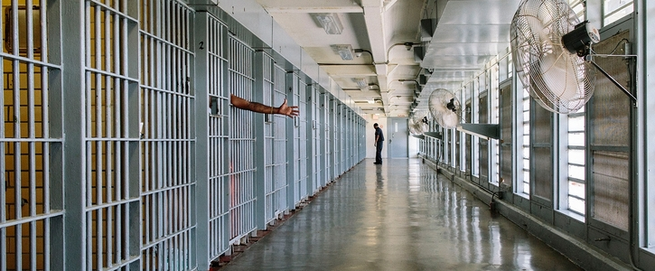
Arsenic Poisoning and Extreme Heat

Slide 23
Genesee County Jail

Slide 24
Puerto Rico’s Prisons in Flood Zones

Slide 25
FCC Beaumont, after Hurricane Harvey

Slide 26
Social Inequality and Incarceration
Notes:
For the next several slides I want to consider how prisons, jails, and detention centers impact people across a broad range of social identities, so that we understand that this affects a lot of people and that race and class are just two ways in which those inequalities express themselves.

Slide 27
Race and Class
Notes:
Race/Class/Gender: The U.S. prison system is overwhelmingly made up of people who are poor and nonwhite.
?The United States of America has the largest prison system of any nation on earth, the largest number of prisoners of any country, and one of the highest percentages of imprisoned persons of any nation. Since 1970, the U.S. has seen a 700% increase in people imprisoned, a result of the growth in city police departments, a “get tough on crime” and “war on drugs” punitive approach to criminal justice, and a concerted effort to control and minimize the power of social movements and other forms of resistance from within communities of color. The United States holds fully 25% of the world’s prison population but has only 5% of the world’s people. As of today there are more than 2.1 million people incarcerated in prisons, jails, immigration detention centers and other correctional facilities in the United States; if all of those prisoners were housed in one location, it would constitute the fourth largest city in the nation. Walmsley 2015. I follow the Human Rights Defense Center’s definition of “prisoner,” which refers to people held in jails, prisons, detention centers, civil commitment facilities, and other spaces where human beings are placed against their will as punishment or while awaiting court-related proceedings such as trials, sentencing, or deportation (see Wright 2015). Lorna Rhodes calls the US prison system a “second nation”
Travis, Western, and Redburn 2014.
Alexander 2012.

Slide 28
Notes:
GENDER. And today women constitute the single fastest growing group of prisoners in the U.S. All of these groups face great risks to human health due to a range of threats inside prisons. Black women in particular are the fastest growing group of people imprisoned in the U.S., making up 29 percent of the imprisoned population but just 7 percent of the U.S. population ("Women’s Mass Incarceration: The Whole Pie 2019 Tweet." Prison Policy Initiative https://act.colorofchange.org/go/297831?t=7&akid=49367%2E2960449%2EqG78QQ)

Slide 29
Immigration Status
Notes:
Immigration Status: The Northwest Detention Center in the Seattle-Tacoma area is a privately operated prison designed to house more than 1500 immigrant detainees and is built adjacent to a federally designated toxic Superfund site. A traditional EJ studies approach to this topic would likely place a primary emphasis on the degree to which there may be a geographic concentration of prisons and jails in communities of color and low-income neighborhoods and what remedies might be sought through state-based policy mechanisms. A Critical EJ Studies approach builds on that perspective and goes further.

Slide 30
Immigration Status
Notes:
Immigration Status: This is a photo of Rohingya refugees in a migrant detention center in Saudi Arabia. In April of 2020, Human Rights Watch issued a report urging Gulf Cooperation Council nations to consider finding alternatives to its practice of imprisoning migrants who are either undocumented and/or who have ”absconded” from their employers. The concern is because of the high risk they face during the COVID-19 pandemic in these carceral facilities. In many detention centers, overcrowding, shared bathrooms, and poor hygiene make it virtually impossible to put into effect basic measures to prevent a COVID-19 outbreak.
?The GCC states – Bahrain, Kuwait, Oman, Qatar, Saudi Arabia, and the United Arab Emirates (UAE) – host large migrant worker populations under various iterations of the exploitative kafala (sponsorship) system, which ties migrant workers’ visas to their employers and leaves them vulnerable to abuse. Across these countries, forms of immigration-related detention are used for purposes other than as a last resort to ensure imminent deportation, often in situations that may be considered arbitrary or otherwise contrary to international human rights standards. Overcrowding is a serious and recurring problem in many of the Gulf states’ prisons and detention centers. Many have unsanitary conditions and inadequate food, water, and medical care, and many detainees experience ill-treatment by prison guards.

Slide 31
Disability
Notes:
DISABILITY: I also explore the fact that, in many U.S. jails and prisons, inmates with mental disabilities are frequently and repeatedly subjected to punishment and pain compliance techniques that include the use of chemical sprays. Effects of these sprays can include intense burning sensations, temporary blindness, second and third degree burns, positional asphyxia, and death. Jeremiah Thomas was an inmate in the Florida State prison system who suffered from mental illness and was subjected to repeated chemical spraying by correctional officers on several occasions, ultimately suffering third degree burns. He recalled that the chemicals would “eat me up on the inside…it burn me real bad and it harmed me” (HWR 2015: 75).

Slide 32
Disability
Notes:
DISABILITY: On the remote Shinan Islands, south of South Korea, recent reports have emerged that mentally disabled people have been trafficked from the mainland and held on the Islands in forced labor conditions that meet the UN’s definition of slavery. Their job: processing organic high-end salt for well-heeled consumers around the world. This is forced/coerced labor in a context where the work they are doing involves natural resource extraction—a clear EJ concern. There are reports that these enslaved people are routinely facing physical abuse on top of their enslavement. So disability is a social category that needs further examination and consideration in EJ studies
Modern slavery of disabled people in South Korea | Unreported World

Slide 33
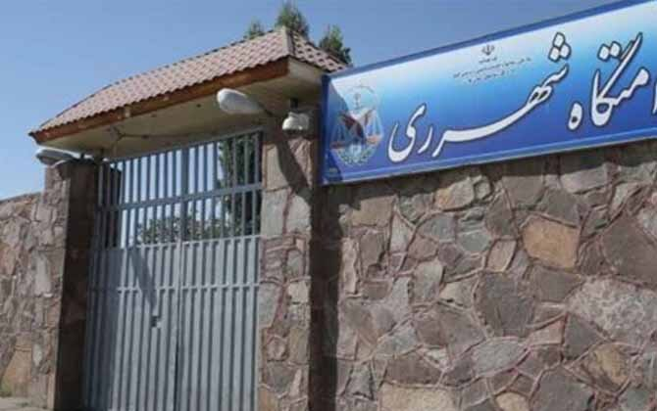
Youth/Age
Notes:
Age/Youth: Left hand side: Oregon Youth Authority. In February of 2017, the Oregon Youth Authority—the government agency that administers the state’s juvenile prison system—began testing the water across its 11 facilities for lead and copper levels. When the results were finalized in early April of 2017, the state reported that 9 of the 11 facilities had actionable levels of lead or copper in their water. The youth incarcerated in OYA prisons range from 12 to 25 years of age.
The U.S. is of course one of many nations that notoriously imprisons youth and children. The Israeli government routinely imprisons Palestinian children deemed security threats and, according to The National Council of Resistance of Iran (NCRI), at Qarchak Prison in Iran (on the right), a number of inmates are mothers who have their children locked up with them. Lack of access to suitable clothes for children and the wards’ unsanitary conditions are only a small part of the problems mothers face in prison.
During an incident in February 2019, when prison guards raided these prisoners, a 20-day infant who was staying with his mother in prison, died due to the tear and pepper gas used against the inmates.

Slide 34
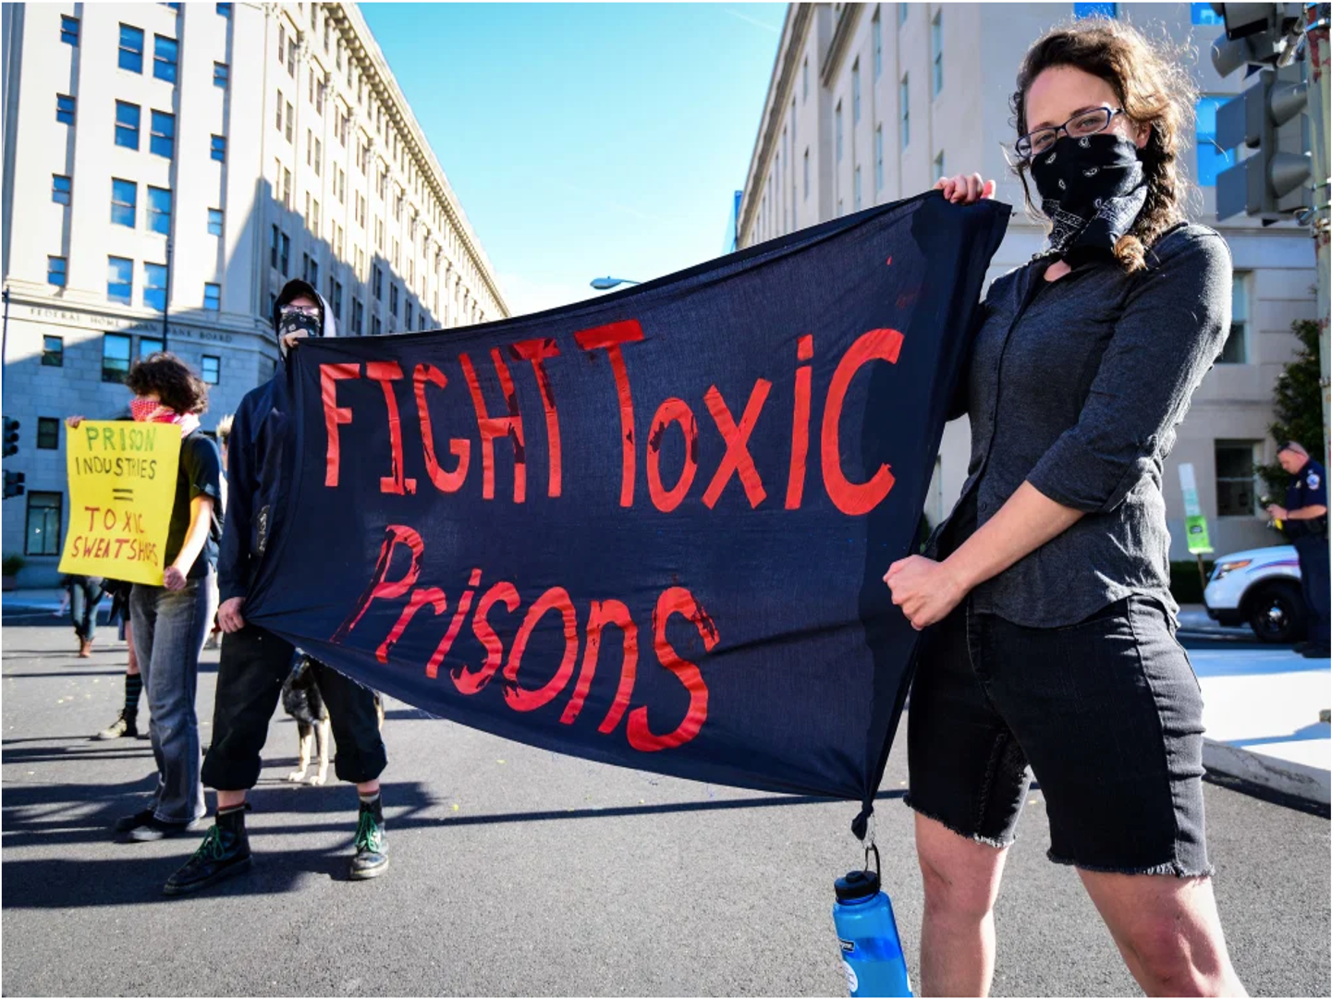
Resistance: Building a Movement
Hunger strikes and labor strikes
Commissary strikes/boycotts
Lawsuits
Demanding clean water, access to showers
Demanding healthy food
Demanding health care
Demanding Educational programs

Slide 35
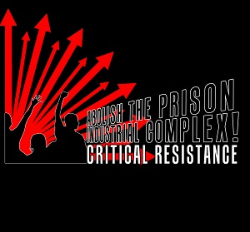
Notes:
In the late 1990s and early 2000s, EJ and anti-prison activists led important campaigns that highlighted troubling intersections between environmental injustice and incarceration. This included groups like Mothers of East LA and Critical Resistance, who challenged the state’s proposals to build carceral facilities in South Central LA and Delano, California.

Slide 36
Resistance
Notes:
Earlier I showed a photo of Rohingya refugees in a Saudia Arabian migrant detention center. Many Rohingya have been imprisoned there for years since they are in the country without authorization. In April of 2019, Rohingya Muslims residing in a Saudi Arabian detention center launched their third hunger strike aimed at protesting the poor conditions within the Saudi detention centers. Reactions by Saudi prison authorities were predictably harsh.
? Authorities reacted by threatening to deprive strikers of water and taking away necessities like pillows, shirts, and other essential items. Saudi Arabia has also begun forcibly deporting Rohingya – often handcuffed – back to Bangladesh, where they face being repatriated to Myanmar.
Saudi authorities have reportedly made it near impossible for the Rohingya detainees to continue their hunger strike. In addition to depriving them of essential items, it has also been reported that Saudi authorities have been forcing Rohingya detainees into “hot rooms.” These rooms use high temperatures to force the exhausted and malnourished Rohingya to give up their hunger strike. At least seven Rohingya have been taken to the hospital to be treated for acute malnutrition since the strike began. Many participating say that it is “unbearable.”

Slide 37
Resistance

Slide 38
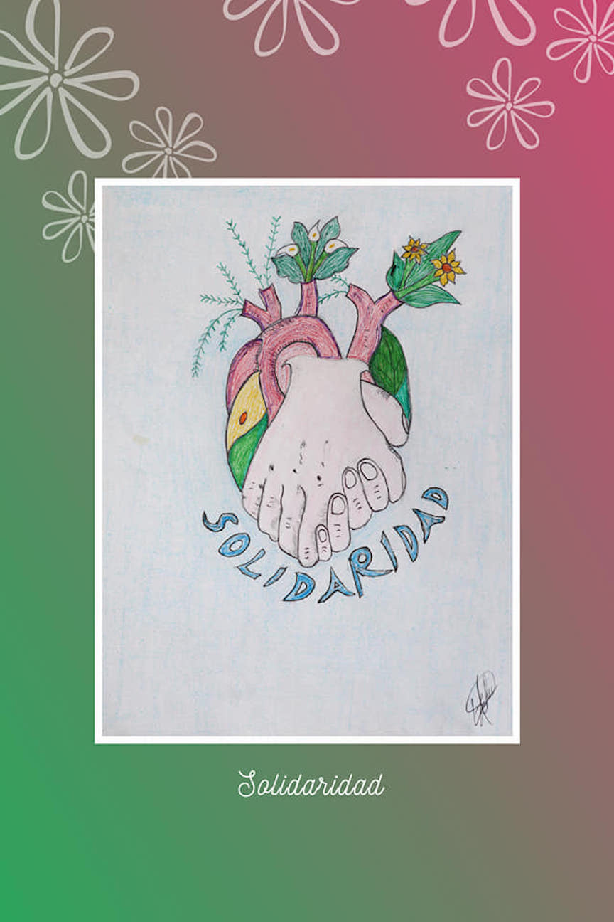
Notes:
These are two drawings from a Tsotsil Indigenous man named Marcelino Ruiz Gomez. He is incarcerated in Chiapas, Mexico under trumped up charges and is working with his colleagues inside and outside the prison to highlight the injustices against his people and to protest the conditions of his confinement. These drawings are part of an exhibition called “Por la vida y la Libertad”, and in my view represent the ways in which incarcerated persons are drawing on deep traditions of creativity and artistry to communicate messages of hope, resistance, and environmental justice even under conditions of total institutional surveillance and racist state violence. Prisoners like Ruiz Gomez are leading the movement for EJ and abolition to new and inspiring heights. Thank you.

Slide 39
Why EJ and prisons?

Slide 40
Why EJ and prisons?
Opportunity to push EJ solutions beyond typical reformist orientation

Slide 41
Why EJ and prisons?
EJ reframing of the environment as those spaces where we “live, work, play, learn, and pray”

Slide 42
Why EJ and prisons?
EJ reframing of the environment as those spaces where we “live, work, play, learn, and pray….and do time”

Slide 43
Why EJ and prisons?
Minority move-in Hypothesis is moot

Slide 44
Why EJ and prisons?
Incarcerated persons are leaders in the EJ movement

Slide 45
Why EJ and prisons?
Incarcerated persons are leaders in the EJ movement, which is also a slave rebellion

Slide 46
Why EJ and prisons?
Incarcerated persons are leaders in the EJ movement, which is also a slave rebellion
EJ movement continues the work of abolitionist movements from centuries ago

Slide 47
Environmental Injustice/Racism as Warfare
Direct assaults by states and state-supported organizations on entire communities
Results in massive harm to those communities and ecosystems
Designed to maintain the health of valued groups
“Environmental justice communities” become targets and enemies
Notes:
Finally, I argue that we might productively recast environmental injustice/racism as a form of warfare for three reasons: 1) it involves direct assaults by state and state-supported organizations on entire communities;
2) This phenemenon results in massive harm to those human communities and ecosystems
3) it is a practice designed to maintain the health of those populations that are highly valued—people who matter—at the expense of those whose lives matter less because they are differentially valued as such (that’s environmental privilege). This framing of environmental injustice is intended to offer an urgency-inducing way of thinking about the seriousness and long-term impacts of public policy and state-sponsored institutionalized violence, all of which are intensified in this era of rising fascism.
What this framing facilitates is a grasp not just of the phenomenon of environmental privilege, but more importantly, how it is routinely weaponized. When we reframe environmental racism as warfare, then we can more clearly see how dominant institutions view those who suffer from and experience these ills, not as “environmental justice communities” or innocent people experiencing unfair environmental harms, but as targets and enemies whose communities, bodies, territories, and identities must be contained, neutralized, and frequently destroyed.

Slide 48
Why EJ?
Diversity is not just a box to be checked
Inequality is perhaps the most important driving force behind socioecological crises
Equality and democracy are good for the environment
Climate denialism’s link to racism is a global problem
The first financial supports for the economic system that produced anthropogenic climate change came from racial violence: colonialism, conquest, genocide, and enslavement

Slide 49
BRYANT ARROYO

Slide 50
Thank you!
Research Team: Elijah Baker, Olive Brogan, Emily Gribble, Hazel Johnson, Fabiana Lake, Ren Levitan, Chloe Ortiz, Carly Marto, Lizzy Privitera, Cambria Wilson
Prison Environmental Justice Project, UCSB
pellow@es.ucsb.edu
http://www.gejp.es.ucsb.edu

