Slide 1
UCPath Update
Administrative Management Professionals | April 29, 2019
Notes:
Opening

Slide 2
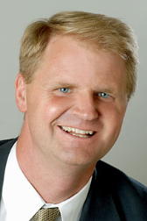
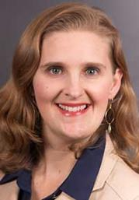
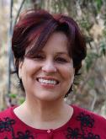
UCPath Leadership
UCPath Leadership
Nathan Brostrom
Rachael Nava
Executive VP & CFO
Executive VP & COO
Mark Cianca
Dan Russi
Mark Cianca
Associate VP, Operational Services
Executive Director UCPath Center
Cristina Jacobson
UCPath Program Director

Slide 3
Why UCPath?
Key drivers for change:
Payroll system replacement needed
38-years old, 11 versions, costly, fragile, outdated
UC in bottom 10% for efficiency compared to benchmark
Most work is high-volume, low complexity, manual
Fragmented processes with high number of staff touches
Existing system prone to error
20% of all work dedicated to fixing errors
Eight UC campuses calculate overtime differently requiring significant rework and employee payments
UC
PATH
ayroll cademic personnel imekeeping uman resources
STANDARD PROCESSES
BUSINESS TRANSFORMATION
SHARED SERVICES
NEW TECHNOLOGY
UCPath delivers robust payroll, HR and administrative services that do not exist today.

Slide 4
UCPath Efficiencies
Convenience
Productivity
Functionality
Single system of record for reporting
Improved visibility of employee data
Streamlined inter-location transfers
Absence management
Automatic leave tracking
Standardized delivery of HR-centric transactions
Consistent tools across UC
UCPath Center support for all UC employees
Performance and recruitment management tools
Centralized payroll and other transactional processing
Current technology that can grow with UC
Common business processes across UC system
One federal payroll tax ID across UC system
Automatic service credit calculations
Position management

Slide 5
UCPath Progress
Completed:
Collaborated with UC experts from all campuses and health systems to develop UCPath business processes
Standardized over 100 HR, payroll, benefits and other business processes for all UC locations
STANDARDIZED PROCESSES
Launched:
Shared services at the UCPath Center in Riverside, CA
UCPath Center now supporting payroll, HR and benefits transactions for more than 100,000 UC employees
SHARED SERVICES
Deployed:
UCOP in production on November 2015
ASUCLA, UCM and UCR in production January 2018
UCLA and UCSB in production September 2018
UCB in production March 2019
ANR and UCD scheduled for October 2019
NEW TECHNOLOGY

Slide 6
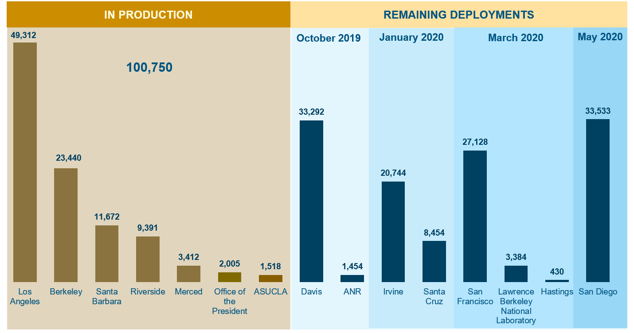
UCPath Deployment Sequence
All UC employees will transition to UCPath

Slide 7
What We Heard: UCPath Functionality
Pain Points
MCOP worksheets
Can’t view transactions in progress
Reporting has made some things clunky
No integration with timesheets
High Points
Payroll transfers are easier
Direct retros instead of UCPAYs
Employee portal
Notes:
Q&A

Slide 8
What We Heard: Processes
Pain Points
Processing timeliness
UCPath Center responsiveness to questions
Overpayment processing
Reconciliation to correct FAU
Fixing incorrect entries
High Points
Payroll transfers are easier
Direct retros instead of UCPAYs
Notes:
Q&A

Slide 9
What We Heard: Training
Pain Points
The REALLY steep learning curve
Inadequate up-front training
Ongoing transactor support
High Points
Job aids
Support labs
Helpful UCPath Center staff
Notes:
Q&A

Slide 10
What We’ve Learned: Other Changes Affect UCPath
FLSA status
Consolidated benefits rate (CBR)
Submission deadlines
Notes:
Q&A

Slide 11
What We’ve Learned: Changes We’re Making
Have a plan for Day 2
Confirm process details with the UCPath Center earlier
Extend UCPath Center hours
Provide onsite support following cutover
Deliver operational workshops closer to when transactions needed
Increase access to reports
Engage higher risk employee populations early and often
Notes:
Q&A

Slide 12
Questions?
Q
A

