Slide 1
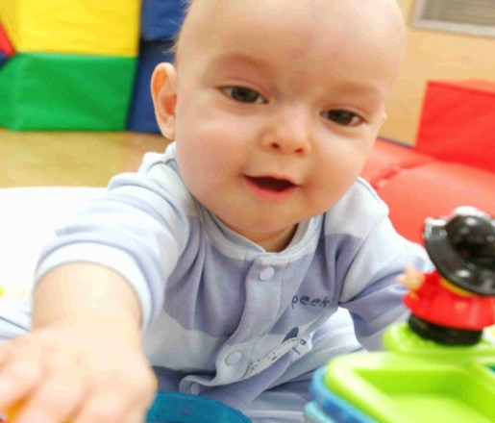
UCLA Medical Center, Santa Monica
The BirthPlace, Santa Monica
Comprehensive maternity services to help expectant parents be ready for their new arrivals.
Comfortable, home-like LDR rooms
Laborist Program
16-bassinet Neonatal Intensive Care Unit
Expanded pediatric services
25-bed Pediatric Unit — the only inpatient pediatric unit in Santa Monica
Operates as a unit of Mattel Children’s Hospital UCLA
Teen Cancer Center
AMP Conference – April 29, 2019
Work Life Balance
Susi Takeuchi
Chief Human Resources Officer

Slide 2
Definition of Balance
A condition in which different elements are equal

Slide 3
Definition of Balance
A condition in which different elements are equal or in the correct proportions

Slide 4
What are Your Work Life Challenges?
My daughter’s big soccer game is the same time as my big work presentation.
I have been working late every night and I miss dinners with my family.
I need to take care of my sick significant other, yet I have a big project due.
I just want to sit in front of the TV to binge watch & eat a bag of chips.

Slide 5
Dilbert on Work Life Balance

Slide 6
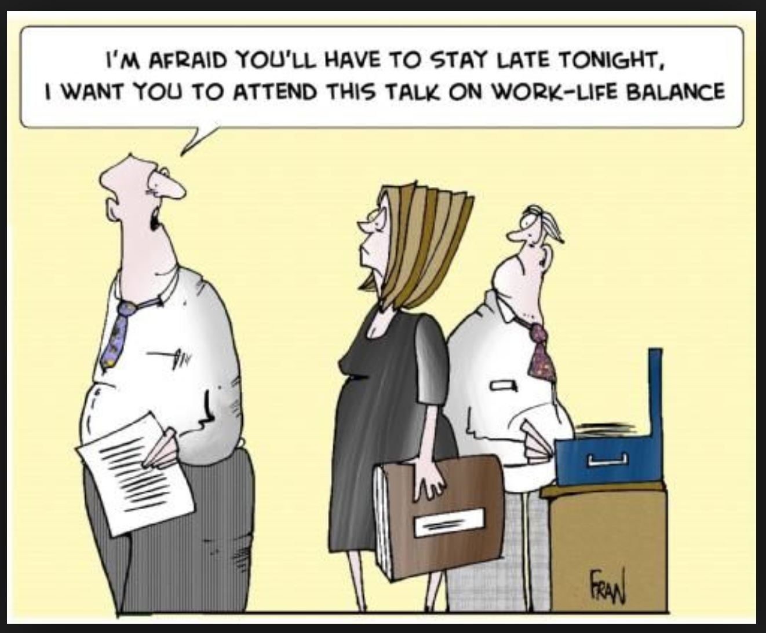
Have you Worked for this Guy?

Slide 7
Approach to Work Life Balance

Slide 8
Work Life Preferences
Integrators
Separators
Work Firsters
Family Firsters
Cyclers
Source: Kick Some Glass

Slide 9
Integrators
Blend work and personal tasks and commitments
Allow work to interrupt family time or family to interrupt work time, or both

Slide 10
Separators
Keep work and personal tasks and commitments separated into defined blocks of time
Focus work on work time and family on family time

Slide 11
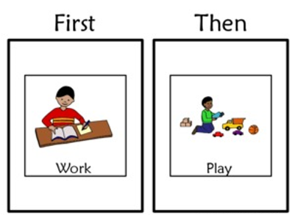
Work Firsters
Allow work to interrupt family, but do not allow family to interrupt work time
Actively involved with business calls, texts or emails at sporting events or on vacation

Slide 12
Family Firsters
Allow family to interrupt work, but do not allow work to interrupt family time
Use technology to stay connected with family while at work

Slide 13
Cyclers
Switch back and forth between cycles of either highly integrating family and work followed by periods of intentionally separating them

Slide 14
What is Your Work Life Preference?
Integrator
Separator
Work Firster
Family Firster
Cycler

Slide 15
Establish a Work Life Plan
Tailored to you and your work life needs
Includes deliberate and intentional goals and strategies
May change over time
Plan includes your:
Goals
Current realities
Work/life preference and alignment to your work/life
Strategies
Notes:
Throughout out my life, I did not have a deliberate and an intentional plan that I wrote down. As I reflect back, I did take steps to try to balance my life, but I have been much more intentional as I got more challenging jobs and balancing everything got more difficult.

Slide 16
What are Your Goals?
Work
Do you desire to be a top performer in your job?
Are you looking to get promoted or are you satisfied with your current job?
Are you seeking a different job opportunity outside of your current scope?
Home
What do you want to do for yourself?
Are you in a relationship and what do you want out of that?
Do you have children and what kind of parent do you want to be?
What do you want to give and receive from your circle of friends and extended family?

Slide 17
My Goals
Provide love, support and guidance to my family
Have a job that challenges me, where I can bring my best performance
Stay connected with friends and extended family to live and laugh
Be healthy

Slide 18
What are Your Current Realities?
Work
I need to learn about project management for my next potential job.
I work 10 hours per day due to my workload.
My manager expects me to be available 24/7.
I am an expert at my job and tend to finish my work early.
Home
I have to pick my kids up from day care by 6:00 pm.
My significant other is very ill.
I have a roommate and we go out all of the time.
It’s just me and I have a lot of time on my hands.
We are empty nesters and have flexibility.

Slide 19
My Realities
Single & Young
Lived at home w/ parents
Attending college
Minimal financial responsibilities
Spent a lot of time with friends
My jobs required work mainly 8 am to 5 pm
Able to master my job responsibilities easily
Married with Kids
Pick up kids by 6:30 pm
Chauffeur kids to activities
Cook, clean, laundry, etc, etc, etc
Spent a lot of time with friends
My jobs required hours beyond 40 hours/week
My job responsibilities were increasingly more challenging
Empty Nester
Kids completed college
Subsidize kids’ expenses
Husband is very ill
Less time to spend with friends
My jobs requires 24/7 availability
My jobs are very challenging and demanding

Slide 20
What is Your Work/Life Preference?
Integrator
Separator
Work Firster
Family Firster
Cycler
How does your preference align with your job/culture and personal life?

Slide 21
My Realities and Preference
Single & Young
Lived at home w/ parents
Attending college
Minimal financial responsibilities
Spent a lot of time with friends
My jobs required work mainly 8 am to 5 pm
Able to master my job responsibilities easily
My Preference: Separator
Job/Culture Needs: Separator
Alignment: Yes
Notes:
Part –time and school full-time, then both full-time, then part-time school and full-time work. In order to accomplish both, I needed and wanted to be a Separator.

Slide 22
My Realities and Preference
Married with Kids
Pick up kids by 6:30 pm
Chauffeur kids to activities
Cook, clean, laundry, etc, etc, etc
Spent a lot of time with friends
My jobs required hours beyond 40 hours/week
My job responsibilities were increasingly more challenging
My Preference: Integrator
Job/Culture Needs: Work First
Integrator
Alignment: No/Yes
Notes:
At SCE, the culture was Work First. You didn’t allow your personal life to interfere with your work life.
At Capital Group, the culture was integrator. Having a busy personal life with kids, it helped to have a work environment that allowed for integration.

Slide 23
My Realities and Preference
Empty Nester
Kids completed college
Subsidize kids’ expenses
Husband is very ill
Less time to spend with friends
My jobs requires 24/7 availability
My jobs are very challenging and demanding
My Preference: Integrator
Job/Culture Needs: Integrator
Alignment: Yes
Notes:
Became CHRO at UCI Health, then UCLA Health.
Integrator work preference aligns with work; but it can be challenging with my husband being ill.

Slide 24
What are Your Strategies to Achieve Your Work Life Goals?
Keep your overall Work Life Goals in mind
Develop deliberate and intentional strategies to achieve your Goals, keeping your Current Realities at the forefront
Strategies may be to achieve better alignment of your job/work culture with your preference
Strategies may focus on goals that have higher priorities in your current life
You should re-visit and adjust your strategies throughout your life

Slide 25
My Strategies
Single & Young
Lived at home w/ parents
Attending college
Minimal financial responsibilities
Spent a lot of time with friends
My jobs required work mainly 8 am to 5 pm
Able to master my job responsibilities easily
My Preference: Separator
Job/Culture Needs: Separator
Alignment: Yes
My Strategies:
Maximize my non-working hours to study
Spend Friday and Saturday nights with friends
Get my work done quickly and accurately
Volunteer for work projects to learn new skills
Notes:
Part –time and school full-time, then both full-time, then part-time school and full-time work. In order to accomplish both, I needed and wanted to be a Separator.
When I worked part-time, my manager was flexible to schedule my work hours around my school hours.
Utilized all of my time efficiently

Slide 26
My Strategies
Married with Kids
Pick up kids by 6:30 pm
Chauffeur kids to activities
Cook, clean, laundry, etc, etc, etc
Spent a lot of time with friends
My jobs required hours beyond 40 hours/week
My job responsibilities were increasingly more challenging
My Preference: Integrator
Job/Culture Needs: Work First
Integrator
Alignment: No/Yes
My Strategies:
Maximize alternate work schedule
Make hard decisions on relative importance on work and home conflicts
Prioritize family over job opportunities that would impact family
Hire help!
Notes:
Married with Kids – Integrator style worked for me, but it was at odds at time
SCE – work environment was Work First. Working with CHRO and told me to come back after 5:00 to regroup.
Mother-in-law – criticizing for choosing work over sick child/ She was Family First, having been a stay at home mom
When work blended into family time, I would consistently hear from my kids, Mom stop working.
I deliberately did not apply for a promotional opportunity because I had young kids and was afraid I couldn’t balance both.

Slide 27
My Strategies
Empty Nester
Kids completed college
Subsidize kids’ expenses
Husband is very ill
Less time to spend with friends
My jobs requires 24/7 availability
My jobs are very challenging and demanding
My Preference: Integrator
Job/Culture Needs: Integrator
Alignment: Yes
My Strategies:
Take care of my husband
Maximize personal time and work time at every possible minute
Manage my meetings better
Plan “me” time
Notes:
Empty Nester
Integrator work preference aligns with work; but it can be challenging with my husband being ill.
Strategies:
Priority to take care of my husband
Surgeries/hospital time – do work during waiting time. (Even waiting in lines, etc. – always connected); Monday nights – work late
Meetings – reduce to 30 minutes, pause to see if I need to attend or delegate, catch someone after a meeting versus having a meeting
Go to the gym, get massages, etc.

Slide 28
Taking Care of Yourself
What is it not:
Taking an annual vacation
What it is:
Emotional well-being
Physical well-being
Nutritional well-being
Financial well-being
Notes:
Sleep

Slide 29
When You are the Manager
Identify strategies to show your support Work Life Balance
Are due dates or assignments flexible?
Are you sending emails on weekends or late evenings?
Can you allow flexible or alternate work schedules?
Are you encouraging time away without working?
Be a role model of Work Life Balance

Slide 30
My Strategies as a Manager
Set realistic and stretch goals while keeping in mind that “Less is More”
Minimize emails on the weekend to my team
Indicate when requests are not urgent
Help employees prioritize their work with their personal responsibilities
Encourage time away and to disconnect/not work on vacation
Notes:
Pause to ask if we are setting too many goals.
Used to say if I send you an email on the weekends, I am not expecting a response. Not good enough/employees still respond. Instead, stop sending emails. Now – minimize sending emails on the weekends; has made my balance better. Emails just bounce back.
Tell employees when I am not expecting something to be done right away.
HELM meeting/Jane attending in absence.

Slide 31
Let’s Develop
Your Plan

Slide 32
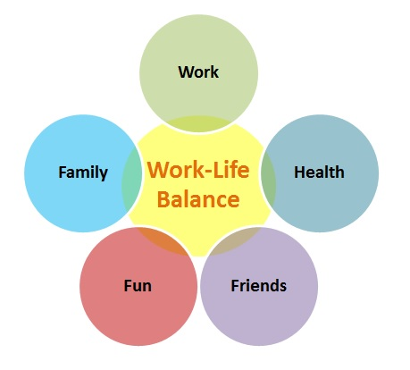
You are in charge of your Balance

Slide 33
UCLA Medical Center, Santa Monica
The BirthPlace, Santa Monica
Comprehensive maternity services to help expectant parents be ready for their new arrivals.
Comfortable, home-like LDR rooms
Laborist Program
16-bassinet Neonatal Intensive Care Unit
Expanded pediatric services
25-bed Pediatric Unit — the only inpatient pediatric unit in Santa Monica
Operates as a unit of Mattel Children’s Hospital UCLA
Teen Cancer Center

